Slide 1
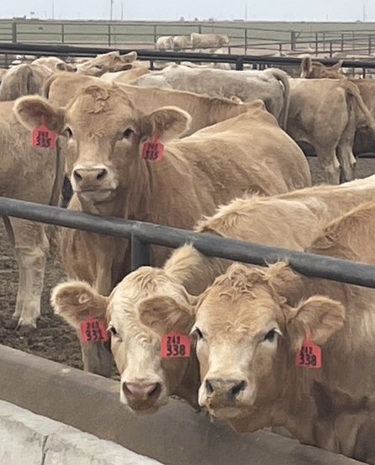
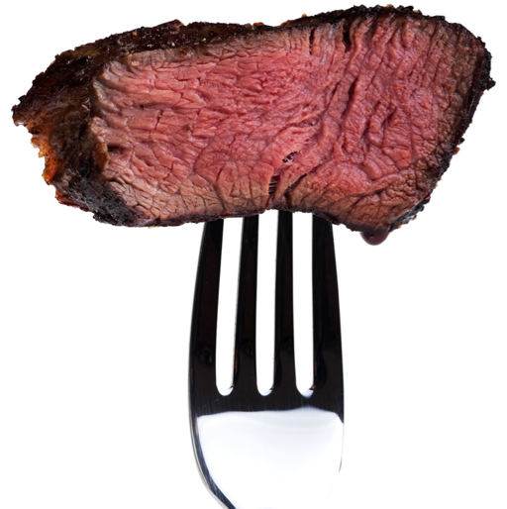
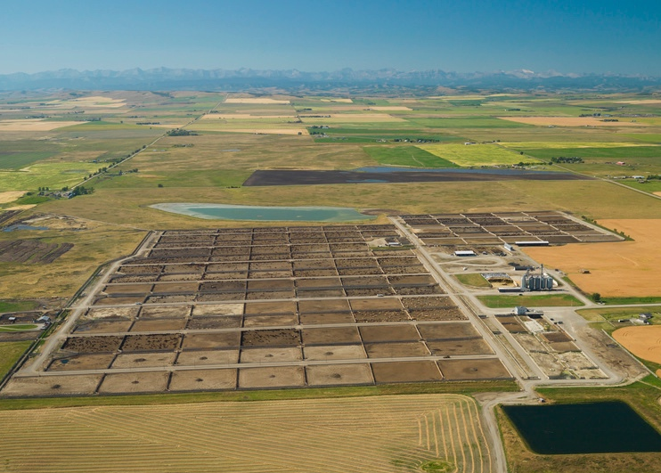

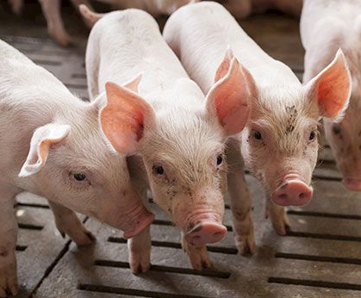
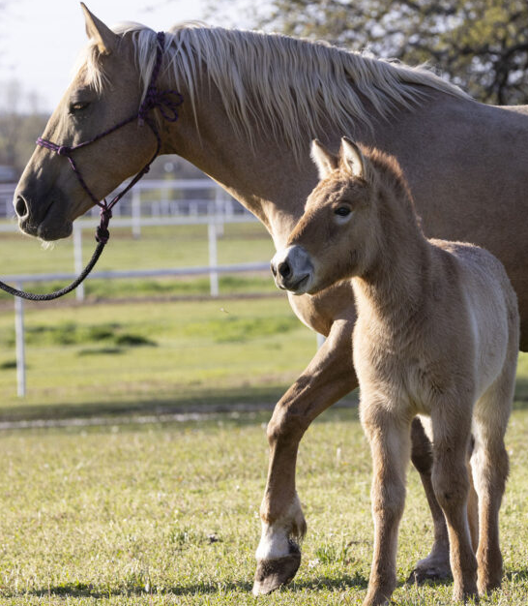
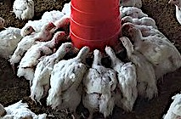
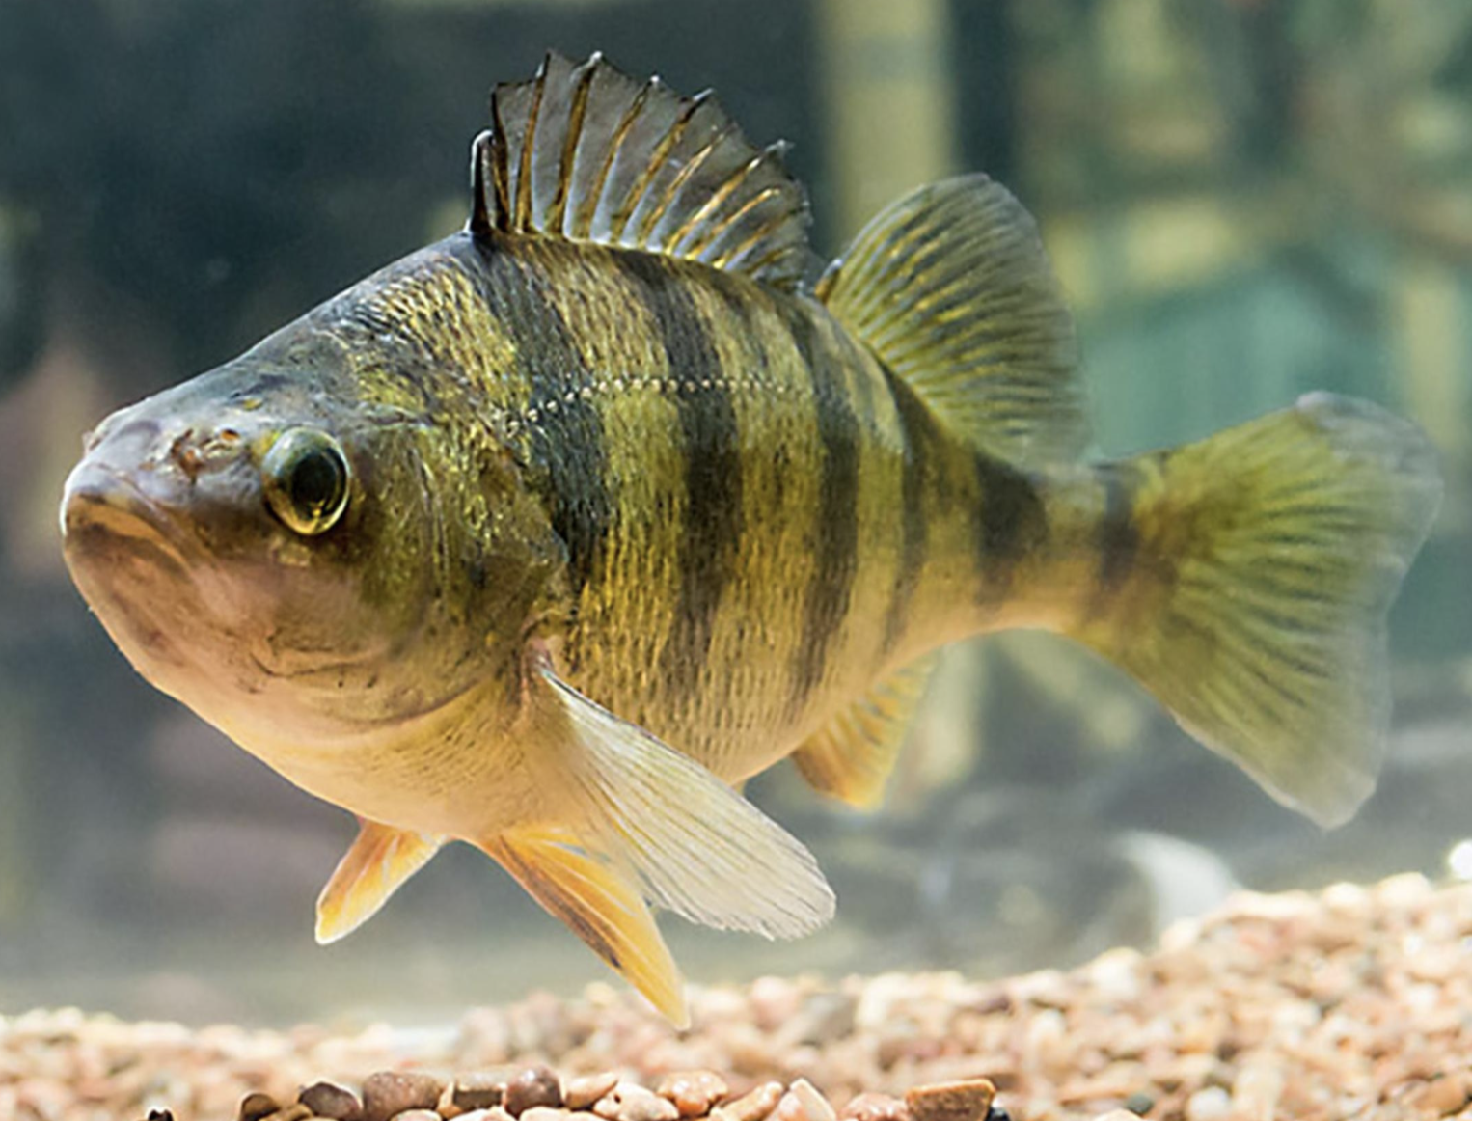


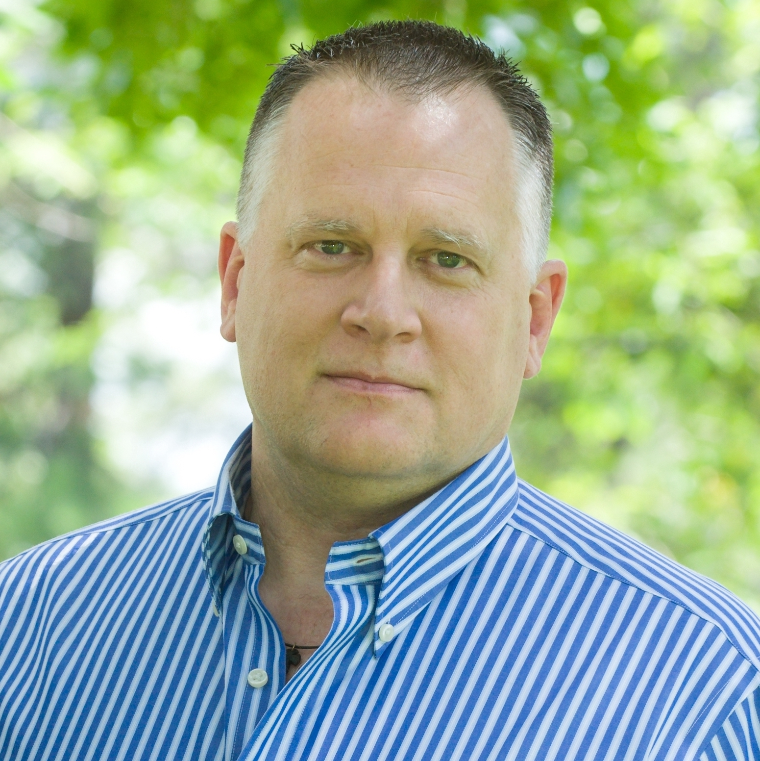
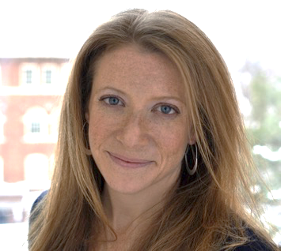
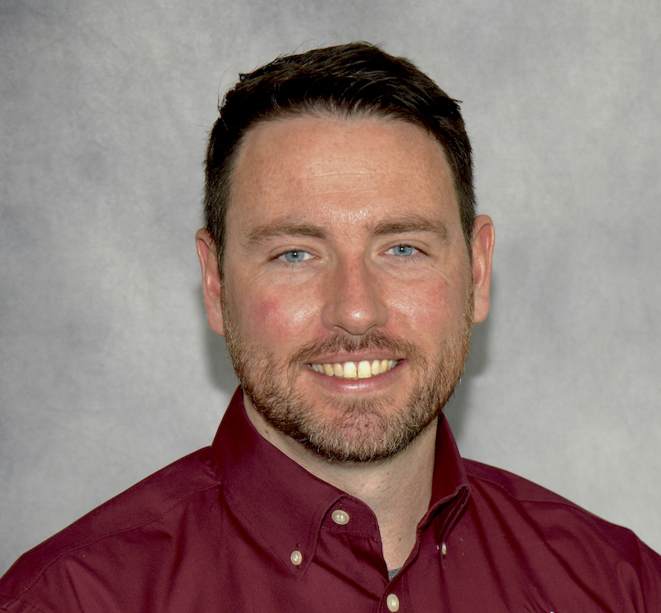
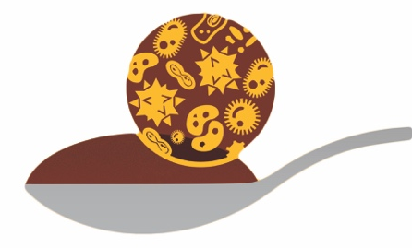
Analysis, Interpretation, and Graphical Presentation of Microbiome & Resistome Data
June 17-21, 2024
UPEI, Canada
Enrique Doster
Peter Ferm
Tara Gaire
Paul Morley
Noelle Noyes
Lee Pinnell

Slide 2
Intro Stuff
Introductions:
Goal:
This course is an introduction to the tools as we use them. It's not a course detailing every method, nor is it a detailed course about all of the concepts. There are ALWAYS other ways to do things!
Handouts
Schedule
Logistics
Zoom – Chat for Q&A
Dropbox for recordings
Slack
Question Box
HPRC

Slide 3
Background Concepts: Microbial Ecology and Metagenomic Sequencing
Paul S. Morley, DVM, PhD, DACVIM (LAIM) Professor and Director of Research Sally Rau McIntosh Endowed Chair
VERO – Veterinary Education Research & Outreach Program
pmorley@tamu.edu
VEROresearch.org

Slide 4
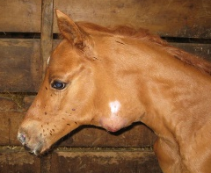
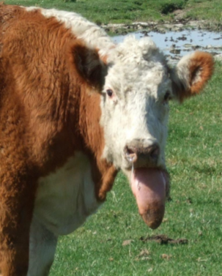
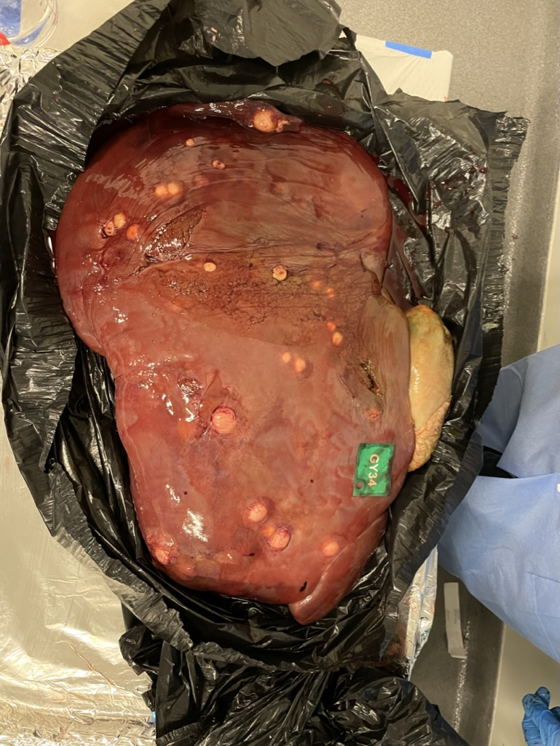
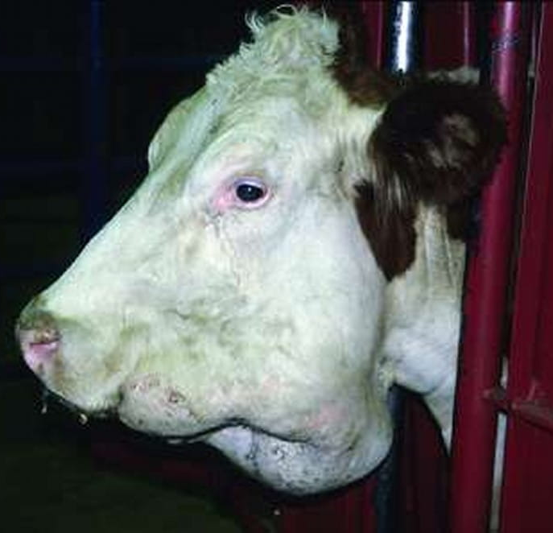
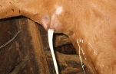
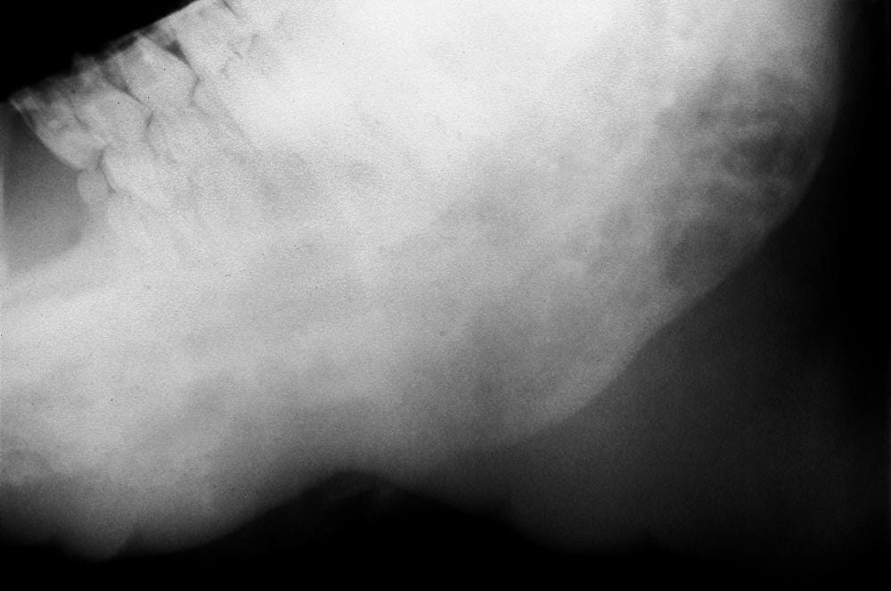
What Causes This Disease?
https://media.cheggcdn.com/
4 Diseases with Pathognomic Signs
https://s3.amazonaws.com/assets.prod.vetlearn.com
https://www.merckvetmanual.com/

Slide 5
Microbes in Health and Disease
Ideas about single agents causing disease have dominated causal thinking since the introduction of the germ theory.
Bacterial, Viral, Fungal, Parasitic agents
Koch’s Postulates
And still persists! (e.g., veterinary school)
Examples – What Causes These Diseases?
Lumpy Jaw (Actinomyces bovis)
Strangles (Strep. equi equi)
Wooden Tongue (Actinobacillus ligneresei)
Liver abscesses (Fusobacterium necrophorum)
Salmonellosis (Salmonella enterica)
Influenza (Influenza Virus)

Slide 6
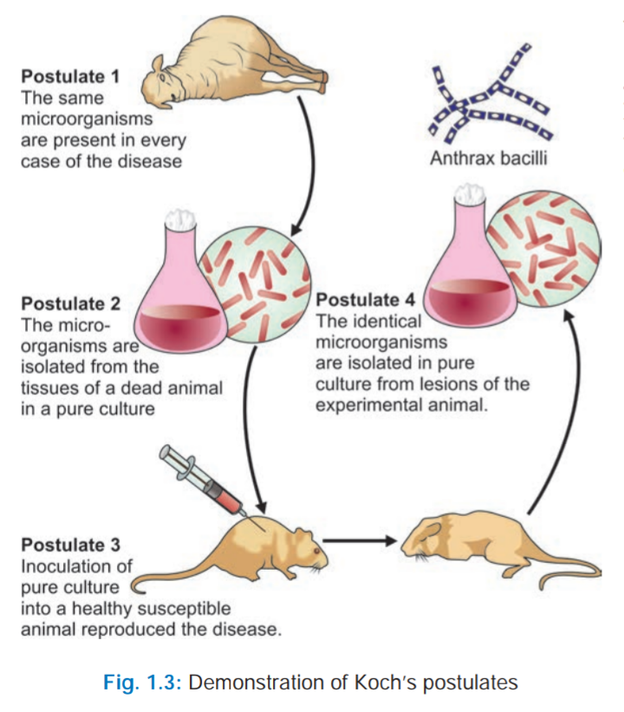
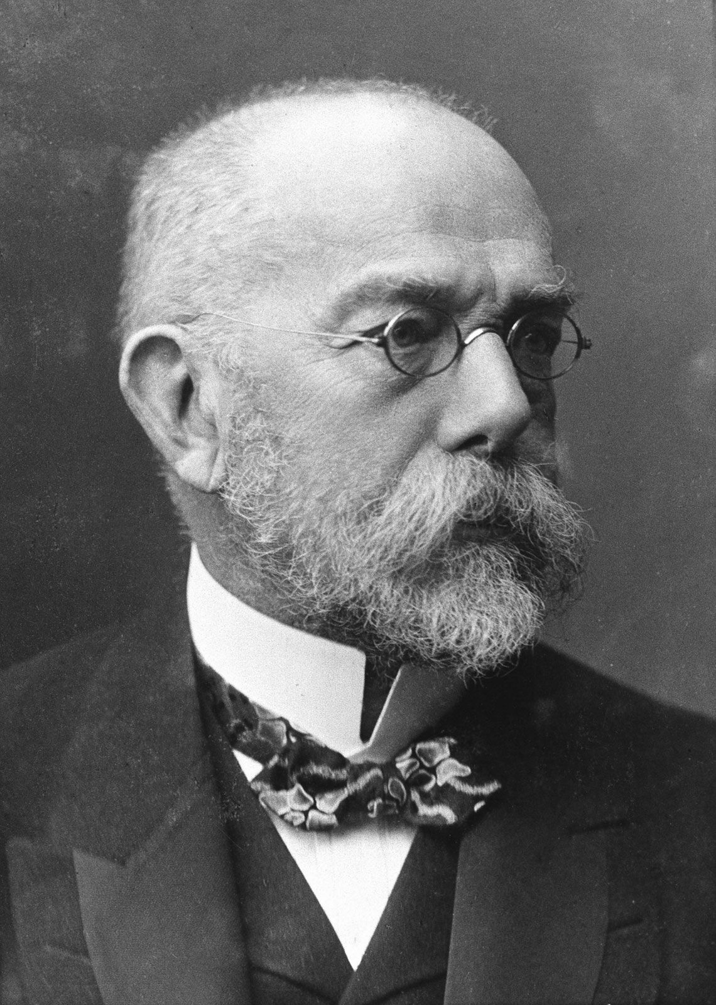
Single Agent Theory – Koch’s Postulates

Slide 7
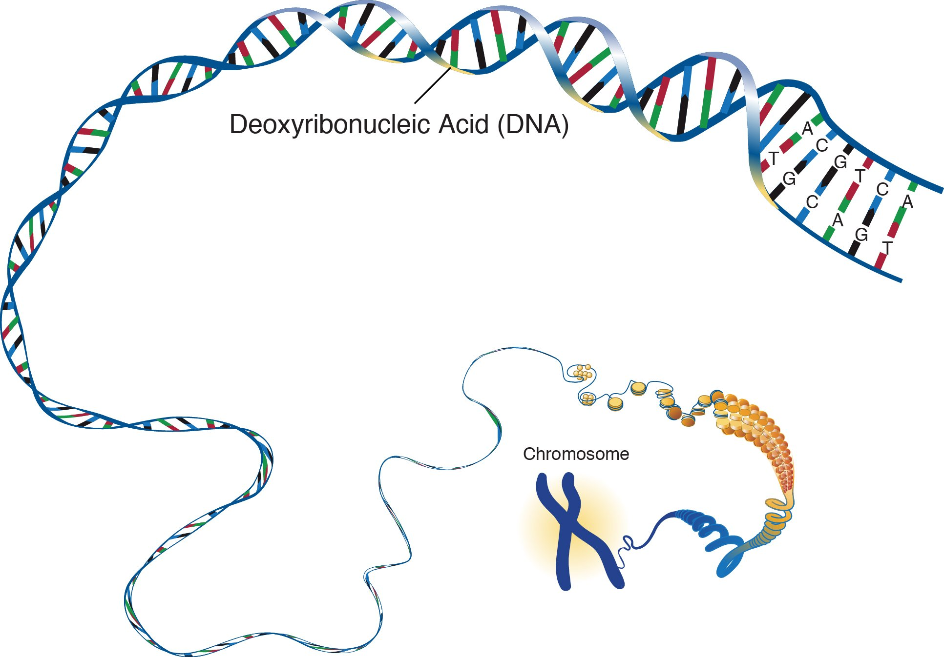
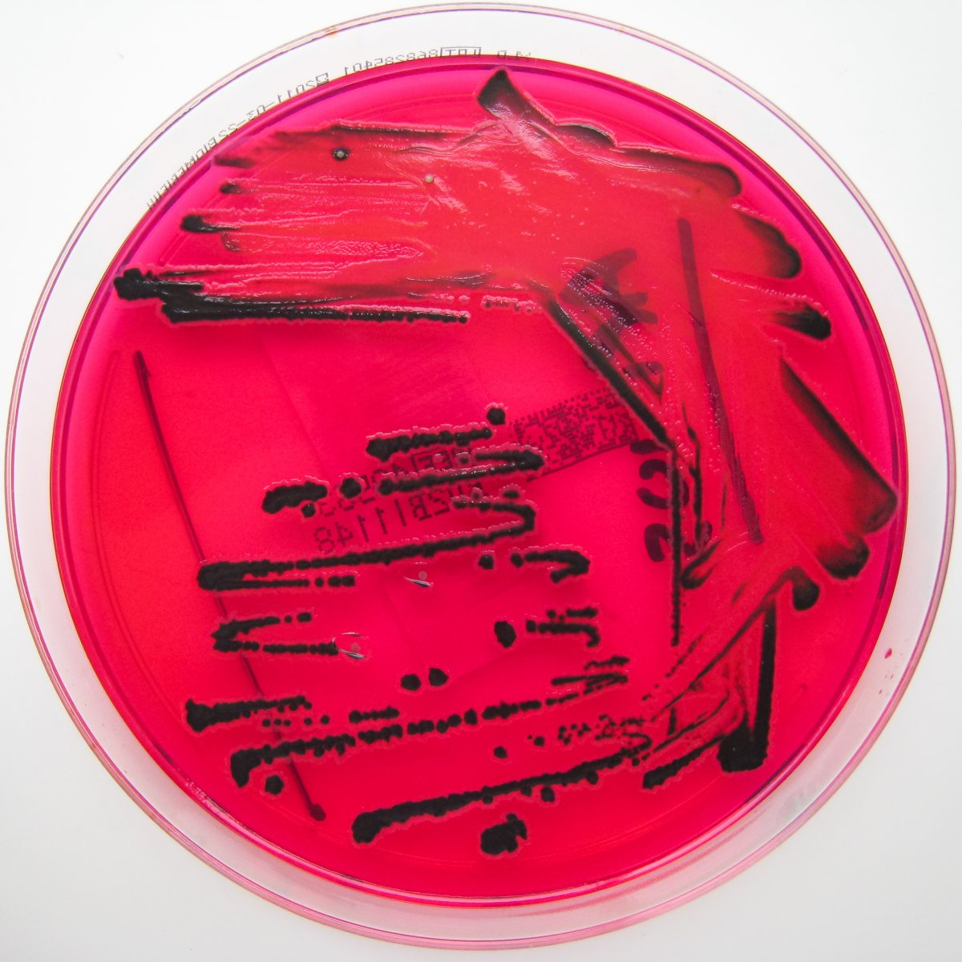
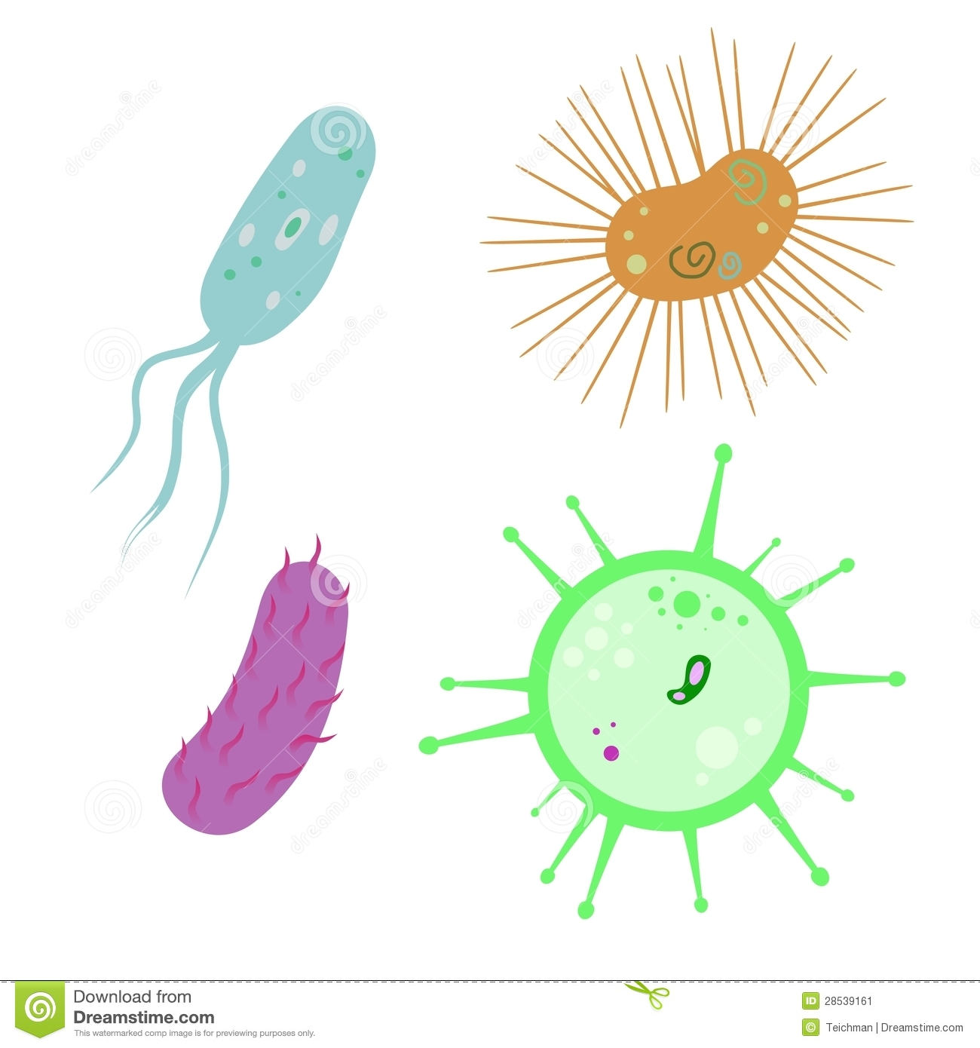
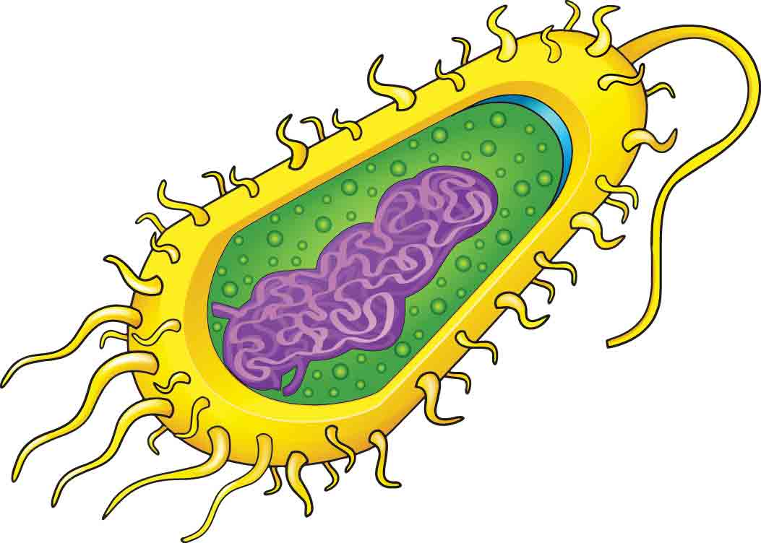
Tools of Molecular Biology Have Revolutionized Our Understanding of Microbial Ecology and Disease Pathogenesis
Metagnomic sequencing enables our ability to characterize and study ALL members of microbial communities.
vs
Ecology of Entire Microbial Populations
Ecology of Individual organisms filtered through the lens of culture
eg. Salmonella
.
.
Photo Credit: Nathan Reading on Flickr
People, Animals, & Environment
http://thumbs.dreamstime.com/z/bacteriahttp://cdn4.kidsdiscover.com/wp-content/uploads/2013/11/4.jpg-virus-28539161.jpg
http://gotsomescienceonyou.files.wordpress.com/2013/04/nhgri-85148.jpg
http://thumbs.dreamstime.com/z/bacteria-virus-28539161.jpg

Slide 8

Ecology
The study of diversity, distribution, and abundance of (micro)organisms, their interactions with each other and the biotic and abiotic features of their environments, and the effects that they have on ecosystems
Gray, ND & Head, IM. in Encyclopedia of Ecology (eds SE Jorgensen & BD Faith) 2357-2368 (Elsevier Science, 2008)

Slide 9
Microbial Ecology & Microbiomes
What is a Microbiome?
Ecological community of all microorganisms (commensal, symbiotic, and pathogenic) found in an ecological niche (including in and on multicellular hosts).
Technically, a microbiome includes bacteria, archaea, protists, fungi and viruses, though more commonly we are referring only to bacterial and archeal taxa.
Who Cares: Microbiota have been found to be crucial for immunologic, hormonal and metabolic homeostasis of their host.

Slide 10
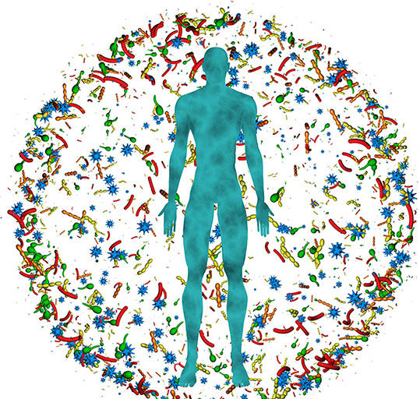
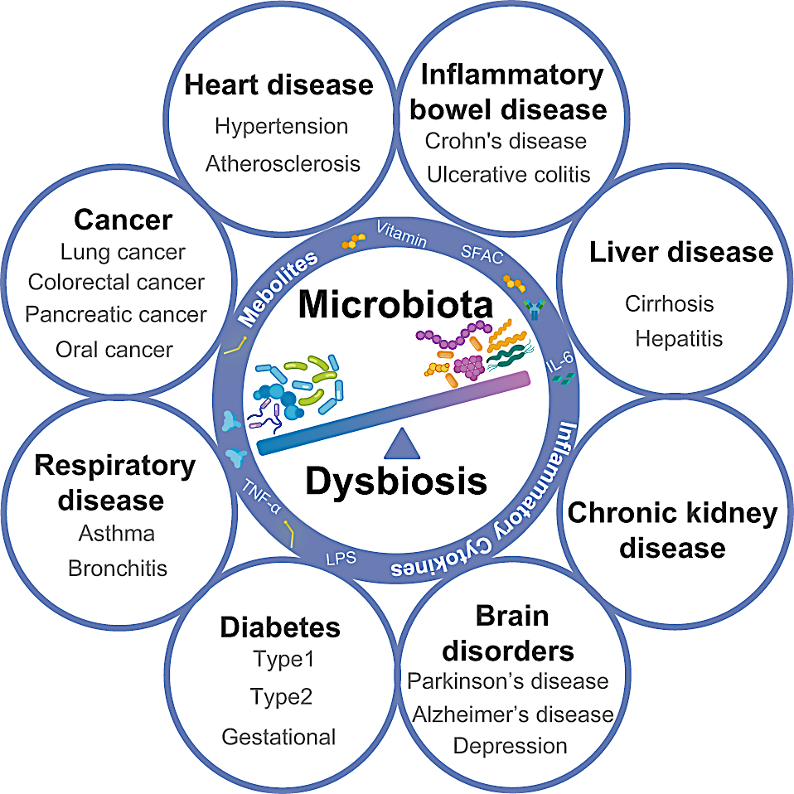
Microbiome and Disease
https://www.niehs.nih.gov/health/topics/science/microbiome
https://doi.org/10.1038/s41392-022-00974-4

Slide 11
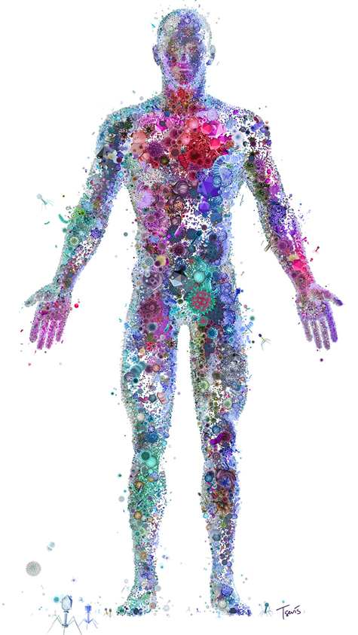
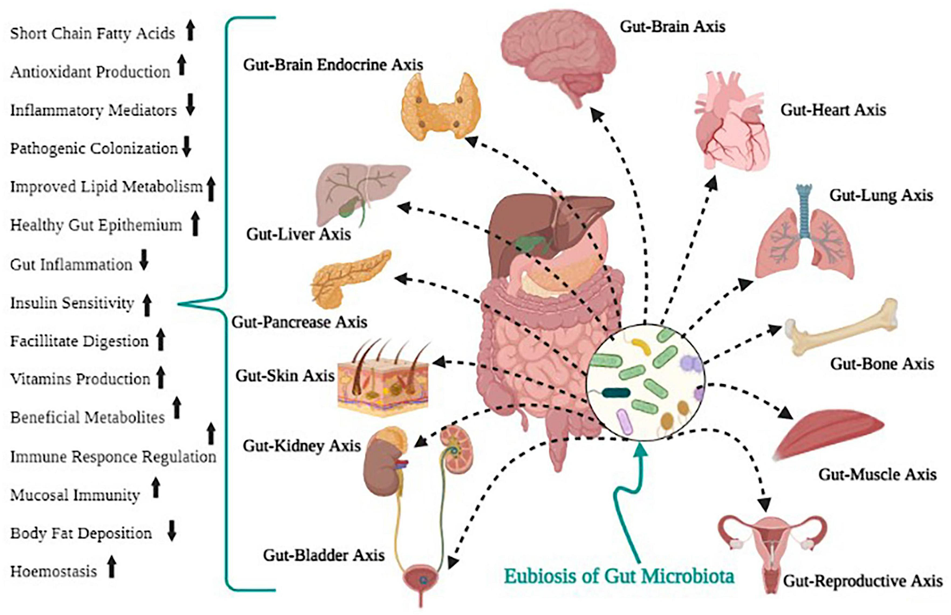
The Microbiome and Health!
- The Invisible Organ -
https://doi.org/10.3389/fmicb.2022.999001
https://dirt.asla.org/2018/06/25/designing-cities-for-healthier-human-microbiomes/

Slide 12
Microbiome in Health and Disease
Sequencing and molecular biology have revolutionized our ability to investigate health and disease.
A true paradigm shift
We can ask questions that were not conceivable without these advancements.
Enables an ability to characterize essentially ALL members of microbial communities.
Provide completely new perspectives
Host (composition and response)
Microbial communities (composition and response)
Interactions
We’ve only just begun!

Slide 13
The ‘Omics’ of Molecular Biology
Genome → DNA → Who is there?
Metagenome; Microbiome; Resistome
Transcriptome → RNA → Which genes are active?
Proteome → Protein translation → Which genes are active?
Metabolome → Metabolic function?
e.g., fatty acids and other metabolites
We Need to Integrate the Different Levels to Obtain a Holistic Understanding of Microbial Ecology

Slide 14
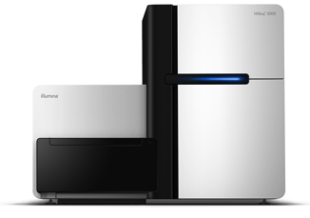
Samples
METAGENOMIC WORKFLOW
PREPARATION
DNA Extraction & Purification
DNA Fragmentation
Library Prep (adapters that allow sequencing & molecular IDs)
PCR amplification (16s and target)
DNA extraction
Library Prep
High-Throughput Sequencing
SEQUENCING (various methods)
BIOINFORMATICS → CLASSIFICATION
Alignment
Assembly (De novo and Scaffold)
Alignment-Free Methods
AGGTCGTGCGTAGTGGTACGAATGTTTACGCGTACCGACAGATAGACGTGTGACCGTACGGTTGGAAGTCGACGTGCAAGGTCGTGCGTAGTGGTACGAATGTTTACGCGTACCGACAGATAGACGTGTGACCGTACGGTTGGAAGTCGACGTGCAAGGTCGTGCGTAGTGGTACGAATGTG
AMR Gene
Annotation
Microbial
Community
Structure
ANALYSIS & INTERPRETATION

Slide 15
Molecular Biology Tools: The Foundations of Microbiome Research

Slide 16
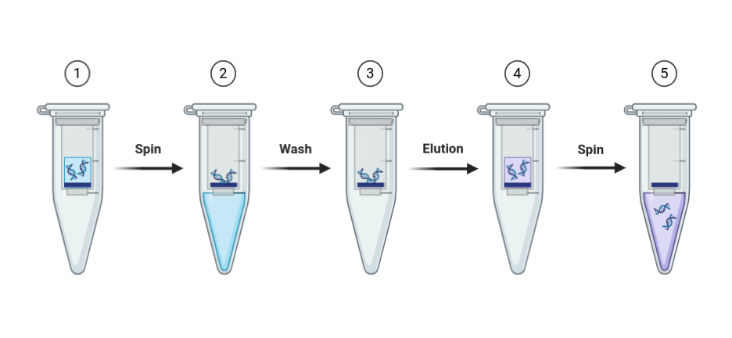
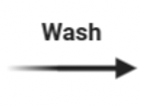
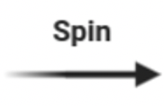

DNA Extraction
Lyse cells (physical, chemical, temperature)
Separate the DNA from the other cell components (chemical)
Isolate the DNA
e.g., Spin Filter techniques
Cell
Disruption
DNA
Binding
Wash
Elution

Slide 17
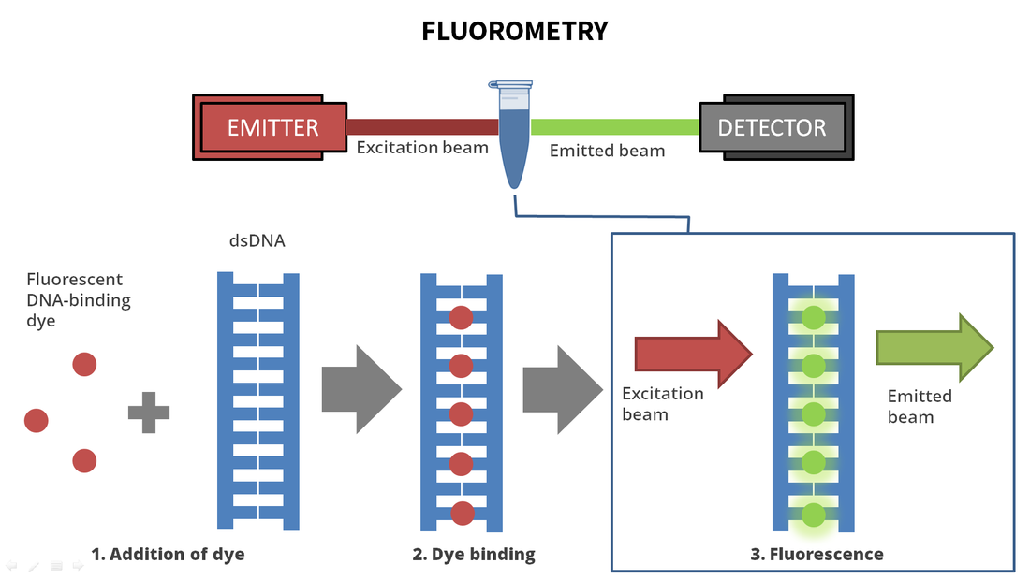
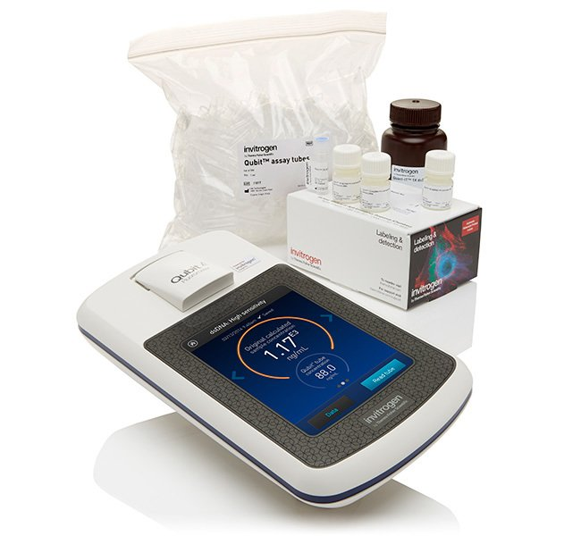
DNA / RNA Quantification and Evaluation
Examples: Fluorometry, UV Absorbance, electrophoresis
Qubit 4 (ThermoFisher) quantifies intact DNA based on the fluorescence intensity of fluorescent dye binding to nucleic acid materials (dsDNA, ssDNA, dsRNA, ssRNA).
Qubit 4

Slide 18
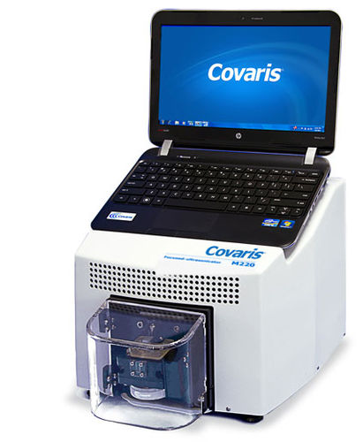
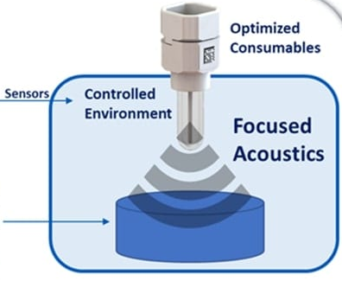
Shearing
Example: Shear by ultrasonification
Adjust fragement size by adjusting frequency, amplitude, time

Slide 19
Amplification: Polymerase Chain Reaction (PCR)
Dr. Kary Mullis - 1985
1993 Nobel Prize in Chemistry
REVOLUTIONIZED LIFE SCIENCES
Made possible because of Taq Polymerase recovered from Thermus aquaticus
Replication of DNA sequences at elevated temperatures that typically denature protein
Common uses
Basis for many molecular biology techniques
Diagnostic detection (PCR, RT-PCR, qPCR, Hybridization)
Amplification for other molecular techniques

Slide 20
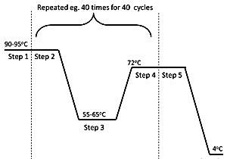
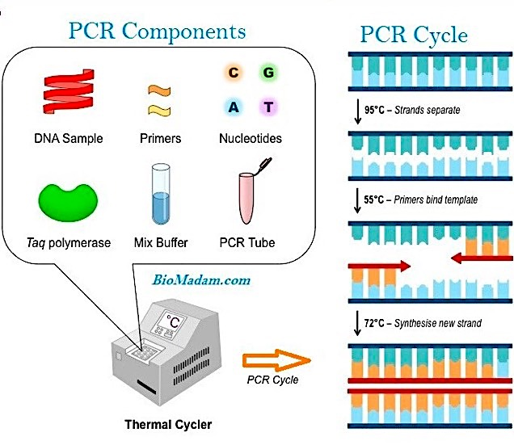
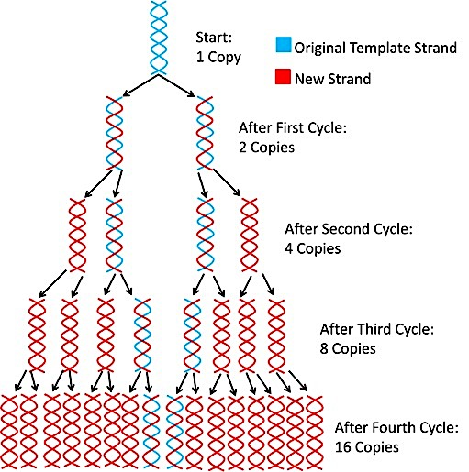
Polymerase Chain Reaction
Template
Temperature
95ºC → Strands Separate = Denaturing
55ºC → Primer binds template = Annealing
72ºC → Synthesize new strand = Extension
https://antisensescienceblog.wordpress.com

Slide 21
PCR Signal Detection – Gel Electrophoresis
https://www.khanacademy.org
Genome Research Limited

Slide 22
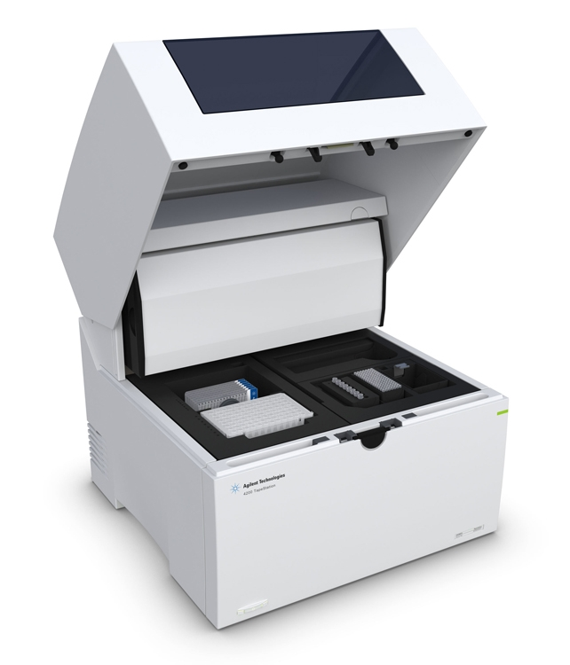
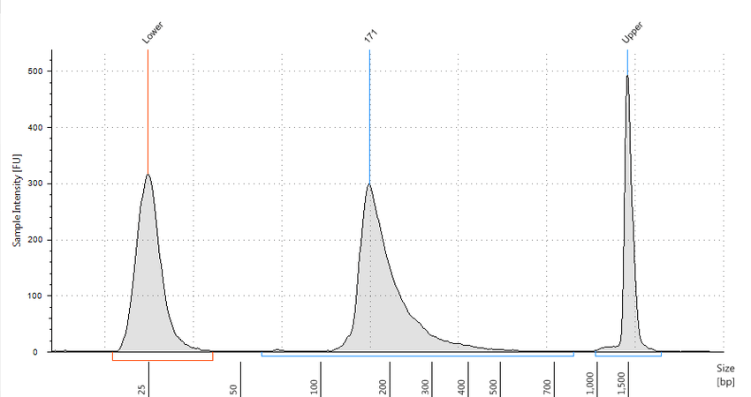
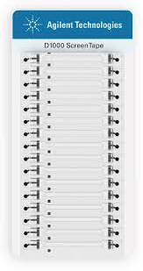
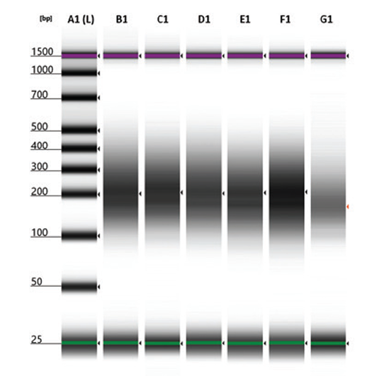
Automated Gel Electrophoresis

Slide 23
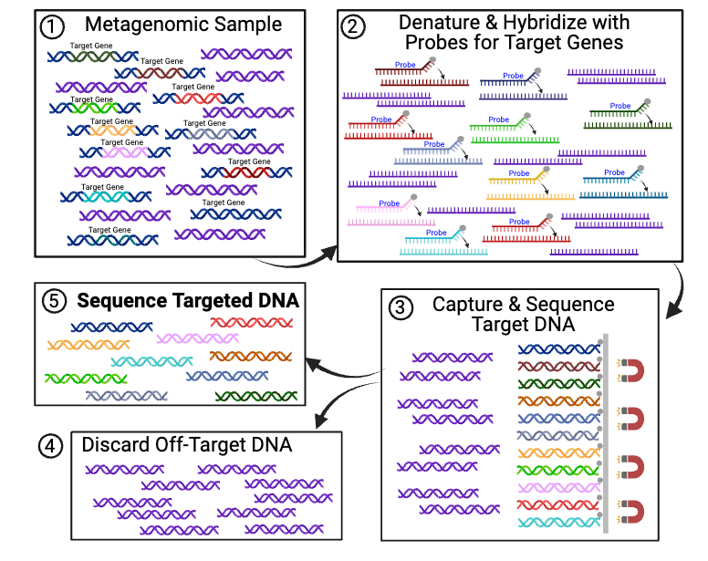
Hybridization-Capture for Target-Enriched Sequencing
www.macmillanhighered.com

Slide 24
Metagenomics or Metagenomics…
“Shotgun” sequencing
Sequencing randomly sheared pieces of DNA
All genomic content in sample
Single genome vs. Metagenomic samples
Frequency of reads generated is proportional to the frequency of DNA sequences in the underlying genome (i.e., there is no selection)
Targeted (marker) sequencing
Only sequence PCR amplicons
16s rRNA gene, 18s rRNA gene, etc.
Pull-down libraries

Slide 25
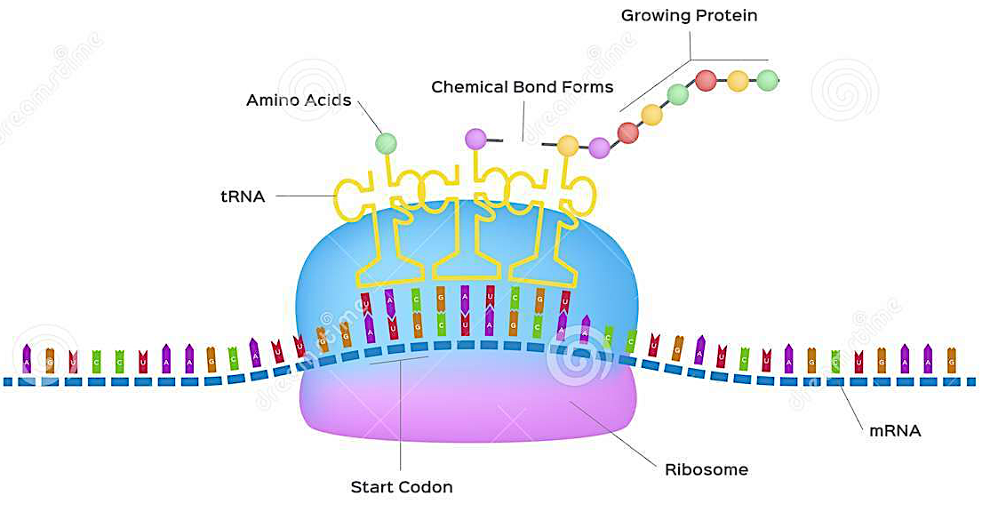
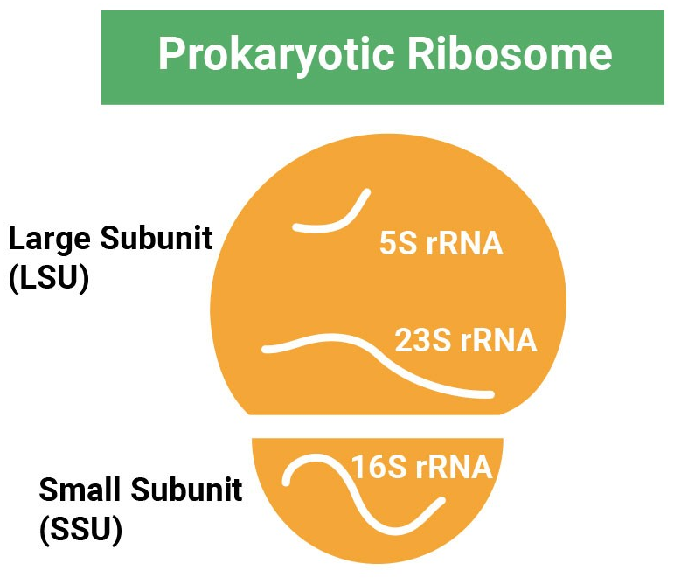
Ribosomes and the 16S rRNA Gene
Protein Translation

Slide 26
16S rRNA Gene Sequencing
Constant regions
Highly conserved among all bacteria
Interspersed with variable regions
Conserved within a bacterial species
Variable among different species
http://www.lcsciences.com/discovery/wp-content/uploads/16s-gene.png

Slide 27
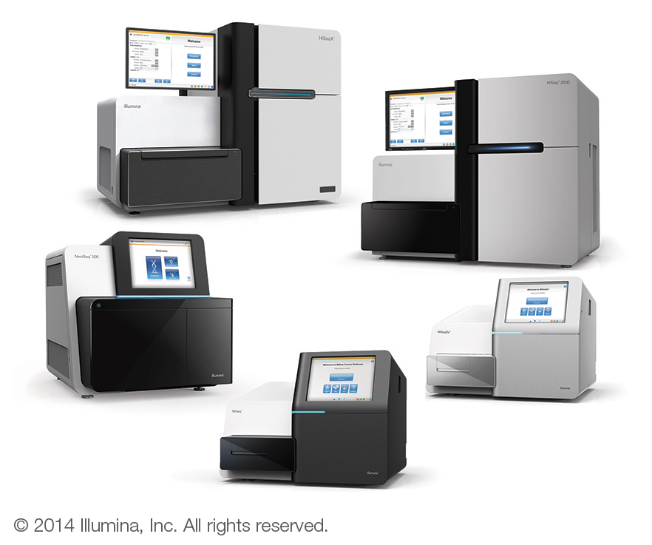
High Throughput Sequencing is Revolutionizing All Areas of Life Sciences!
Sequencing costs have dropped ~100,000-fold since 2001
From ~$9,000 per Mbase of raw sequencing in 2000 to about $0.09 today!
Rapid, “desktop” sequencing is a reality!
So is “industrial-strength,” “high-volume”
https://nanoporetech.com/products/minion

Slide 28
Choices for High-Throughput Sequencing
Long Read
Short Read
Examples: PacBio, MinION
10-15Kb reads (PacBio)
Higher base call error rate (15-20%)
Less common (esp metagenomics)
Lower output per run
Higher cost per Gb
Illumina [Nova-, Hi-, Mi-, Mini-]seq
150-300 base reads
Low base call error rate (0.001-0.0001%)
Very common, highly accessible
Higher output (more Gb per run)
Lower cost per Gb

Slide 29
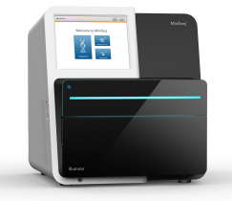
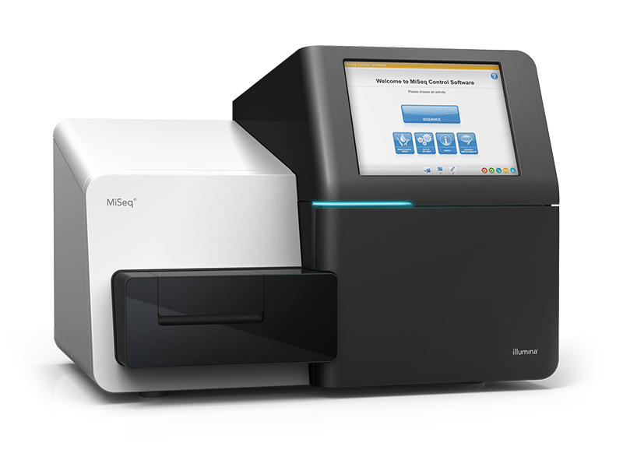
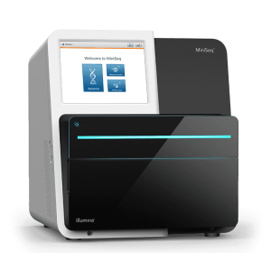
Choices for High-Throughput Sequencing
(throughput, read length, paired/single, error rate, cost per Gb)
Long Read
Short Read
Illumina NovaSeq 6000
Flow cells SP/S1/S2/S4 4800-6000 Gb / run
Up to 40 Billion reads / run
2x 50-250 bp reads
PacBio rsII
500Mb - 1 Gb / run
50k reads/run
10-15kbp reads (mean)
10-15 Kb reads possible
15% error (single pass)
PacBio Sequel
5-10 Gb / run
500k reads/run
10-15kbp reads
10-15 Kb reads possible
15% error (single pass)
Illumina NextSeq
120 Gb / run
Up to 25 Million reads / run
2x 50-150 bp reads
Illumina MiSeq
15 Gb / run
Up to 25 Million reads / run
2x 25-300 bp reads
Nanopore MinION
10-30 Gb / run
>2Mbp reads possible
5-20% error
Nanopore PromethION
315 Gb / run
>2Mbp reads possible
5-20% error
Illumina MiniSeq
7.5 Gb / run
Up to 25 Million reads / run
2x 150 bp reads
http://www.pacb.com/
https://nanoporetech.com/products/minion
https://www.illumina.com/

Slide 30
Choices for High-Throughput Sequencing
Long Read
Short Read
Examples: PacBio, NanoPore
15Kb reads – 5Mb
Much higher error rate (15-20%)
(newer chemistry?)
Increasingly common
Lower output per run
Higher cost per Gb
Illumina [Nova-, Next-, Mi-, Mini-] seq
150-300 base reads
Low error rate (0.001-0.0001%)
Very common, highly accessible
Higher output (more Gb per run)
Lower cost per Gb
But…
Sequencing provides unprecedented ability to examine microbial communities
Does not replace utility of other diagnostics (e.g., PCR, Array, LFIA)
Sensitivity, taxonomic specificity, cost, ease of application

Slide 31
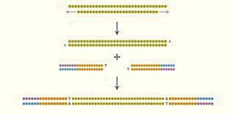


Illumina Library Prep & Sequencing by Synthesis
Library Preparation
Randomly fragment DNA
Ligate adapters to both ends
Denature to form ssDNA
Cluster Generation
ssDNA hybridizes to flow cell
Complementary adapter binds to form bridge.
Solid-phase amplification creates clusters of identical DNA fragments.
Attach sequencing primers.
Sequencing
All 4 tagged nucleotides added, but only 1 incorporated per cycle.
Laser excites fluorophore, camera records base identity.
Changing the number of cycles changes the length of read.
https://youtu.be/fCd6B5HRaZ8?si=kgqUrip3ZOqKKP08
https://www.fulgentgenetics.com/products/sequencing/rentalane.html
http://mmg-233-2013-genetics-genomics.wikia.com/wiki/File:Illumina4.jpg
gsc.ku.edu

Slide 32


Things to note:
Sequencing Adapters
Sample Barcodes (Indexes)
Multiplexing

Slide 33
Sequencing Depth: Because Lane Space is a Fixed Resource
How much sequence data is generated per sample depends on how much “space” is available for a given sample.
Lanes are loaded with approx same quantity of DNA, and the lane space is fixed…
More samples per lane ➔ less sequencing data per sample
More genomic information (bigger genome, abundant microbiota, more diversity, etc)
➔ More data needed to fully characterize genome(s)
➔ More space needed
➔ Fewer samples per lane/run

Slide 34
The sequencing process inevitably results in uneven “Sequencing Depth” (i.e., numbers of “reads”) across samples:
Pareto Chart
Histogram
Reads Per Sample
Number of Samples
Sample ID
Reads Per Sample
n=335 Samples (670 PE reads)

Slide 35

Have I Sequenced Deep Enough?
One tool is rarefaction
= Coverage of the Community
Concept of "diminishing returns"
An ecological approach to graphing species (or AMR) richness as a function of sequence depth (or sample number)
doi: 10.3389/fmicb.2021.621069

Slide 36
Managing Lane Effect
Lane 1 Lane 2 Lane 3
Lane 1 Lane 2 Lane 3
Concatenate Reads from 3 Lanes
VERSUS
Lane 1
Lane 2
Lane 3

Slide 37
Bioinformatics & Statistical Analysis
AMR++ Bioinformatic Pipeline for Antimicrobial Resistance Characterization in Metagenomic Samples
Notes:
- So how do we actually correct for Illumina systemic bias?
- We do this with read trimming, which is done as the first step in the AMR++ pipeline.

Slide 38

Alignment & “Pile up” (Sequencing Depth)
= coverage of a specific sequence
Aligned
Reads
Reference Sequence
~150 bp “hits” aligning to TetQ gene

Slide 39






Slide 40
Samples
METAGENOMIC WORKFLOW
PREPARATION
DNA Extraction & Purification
DNA Fragmentation
Library Prep (adapters that allow sequencing & molecular IDs)
PCR amplification (16s and target)
DNA extraction
Library Prep
High-Throughput Sequencing
SEQUENCING (various methods)
BIOINFORMATICS → CLASSIFICATION
Alignment
Assembly (De novo and Scaffold)
Alignment-Free Methods
AGGTCGTGCGTAGTGGTACGAATGTTTACGCGTACCGACAGATAGACGTGTGACCGTACGGTTGGAAGTCGACGTGCAAGGTCGTGCGTAGTGGTACGAATGTTTACGCGTACCGACAGATAGACGTGTGACCGTACGGTTGGAAGTCGACGTGCAAGGTCGTGCGTAGTGGTACGAATGTG
AMR Gene
Annotation
Microbial
Community
Structure
ANALYSIS & INTERPRETATION

Slide 41
Questions and Discussion?

